Slide 1

“Attendance 2.0”
A Modern Take on Time Tracking with Facial Recognition
Team - 12

Slide 2
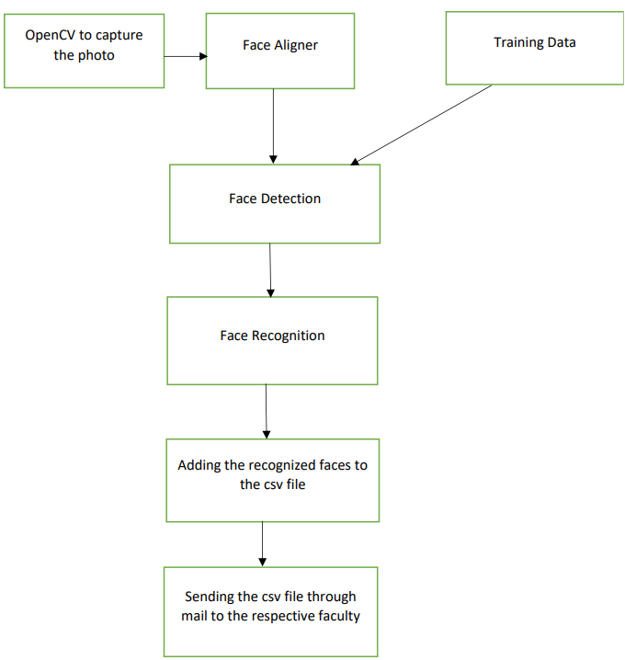
Agenda

Slide 3
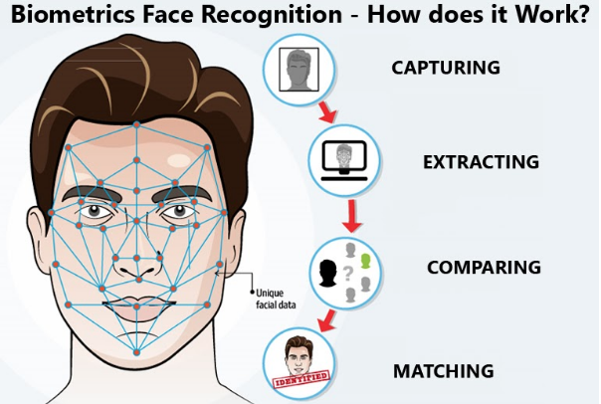
Introduction
A face recognition attendance system is a type of attendance tracking system that uses facial recognition technology to identify and record the attendance of individuals.
These systems typically consist of a camera or other imaging device, software for analyzing and recognizing faces, and a system for storing and tracking attendance data.
To use a face recognition attendance system, individuals simply need to look at the camera, and the system will automatically recognize their faces and record their attendance.
This type of system can be used in a variety of settings, including schools, offices, and other organizations, to efficiently and accurately track attendance.

Slide 4
Methodology
OpenCV
Haar cascades
Face Aligner(Done from scratch)
LBPH Face Recognizer
Tkinter
SMTP

Slide 5

OpenCV
OpenCV is the huge open-source library for computer vision, machine learning, and image processing and now it plays a major role in real-time operation
Applications of OpenCV:
face recognition
Automated inspection and surveillance
Robot and driver-less car navigation and control
OpenCV Functionality:
Object/feature detection (objdetect, features2d, nonfree)
Machine learning & clustering (ml, Flann)
CUDA acceleration (GPU)

Slide 6

Tkinter
Tkinter is a Python library for creating graphical user interfaces (GUIs). It is built on the Tk GUI toolkit and provides a simple, yet powerful, way to create GUI applications using Python. and it provides a wide range of widgets and other tools for building GUI applications.

Slide 7
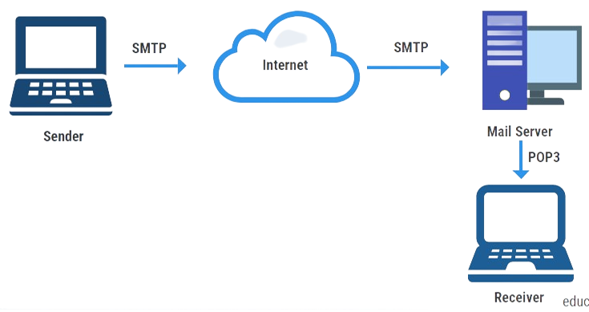
SMTP
SMTP (Simple Mail Transfer Protocol) is a protocol used for sending and receiving email messages over the internet. It is a standard protocol that is used by most email systems, including popular email service providers like Gmail, Yahoo, and Outlook. SMTP is a simple, text-based protocol that uses a series of commands and responses to transfer email messages between servers. It is typically used to send messages from one server to another, but it can also be used to deliver messages directly to a recipient's mailbox. SMTP is a reliable and efficient way to transfer email messages, and it is an important part of the internet's infrastructure.

Slide 8
Haar Cascades
Haar Cascade classifiers are an effective way for object detection. Haar Cascade is a machine learning-based approach where a lot of positive and negative images are used to train the classifier.
Positive images – These images contain the images which we want our classifier to identify.
Negative Images – Images of everything else, which do not contain the object we want to detect.
The algorithm can be explained in four stages:
Calculating Haar Features
Creating Integral Images
Using Adaboost
Implementing Cascading Classifiers

Slide 9
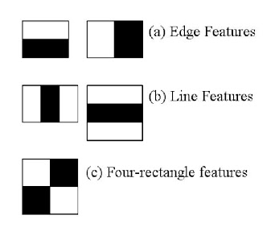
Calculating Haar Features:-
A Haar feature is essentially calculations that are performed on adjacent rectangular regions at a specific location in a detection window. The calculation involves summing the pixel intensities in each region and calculating the differences between the sums.

Slide 10
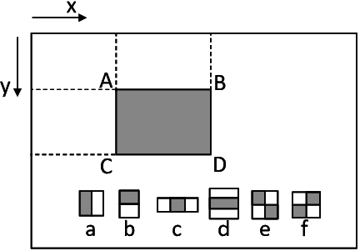
Creating Integral Images
Without going into too much about the mathematics behind it, integral images essentially speed up the calculation of these Haar features. Instead of computing at every pixel, it instead creates sub-rectangles and creates array references for each of those sub-rectangles. These are then used to compute the Haar features.

Slide 11
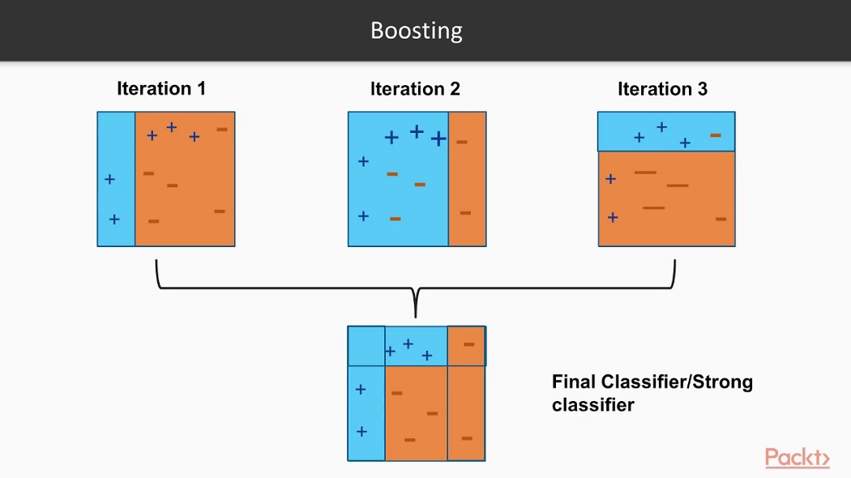
Adaboost Training
Adaboost essentially chooses the best features and trains the classifiers to use them. It uses a combination of “weak classifiers” to create a “strong classifier” that the algorithm can use to detect objects.

Slide 12
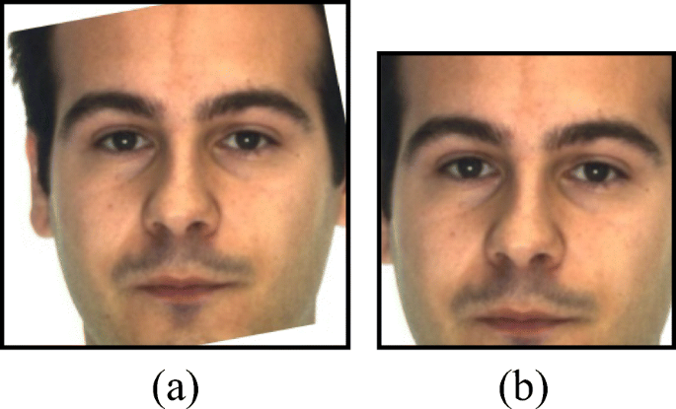
Face Alignment
Image alignment refers to the process of aligning or registering an image concerning a reference image or coordinate system. This is often necessary for computer vision applications, such as face recognition, where the position and orientation of the face in the image can affect the accuracy of the recognition algorithm.
To align an image, a face detection algorithm is typically used to detect the position and orientation of the face in the image. This information is then used to rotate and translate the image so that the face is correctly aligned with the reference coordinate system.
In other cases, more complex methods, such as affine or perspective transformations, may be needed to accurately align the image. Regardless of the approach used, the goal of image alignment is to improve the accuracy and reliability of the face recognition algorithm.
Original image
Aligned image

Slide 13
LBPH Face Recognition
LBPH (Local Binary Patterns Histograms) is a simple, yet effective, method for recognizing faces that are based on local patterns in the image. LBPH works by dividing the image into small blocks, called "cells," and then comparing the pixels in each cell to its neighbors. This produces a binary pattern for each cell, which is then used to create a histogram that represents the face. This histogram is compared to the histograms of known faces to determine if the face in the image is a match.
1. Parameters: the LBPH uses 4 parameters:-
Radius
Neighbors
Grid X
Grid Y

Slide 14
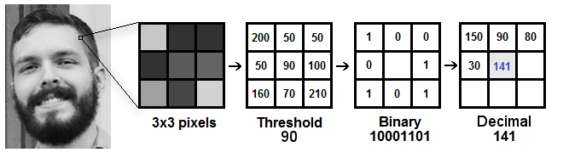
2. Training the Algorithm: First, we need to train the algorithm. To do so, we need to use a dataset with the facial images of the people we want to recognize. We need to also set an ID for each image, so the algorithm will use this information to recognize an input image and give you an output. Images of the same person must have the same ID. With the training set already constructed, let’s see the LBPH computational steps.
3. Applying the LBP operation: The first computational step of the LBPH is to create an intermediate image that describes the original image in a better way, by highlighting the facial characteristics. To do so, the algorithm uses a concept of a sliding window, based on the parameter’s radius and neighbors.

Slide 15
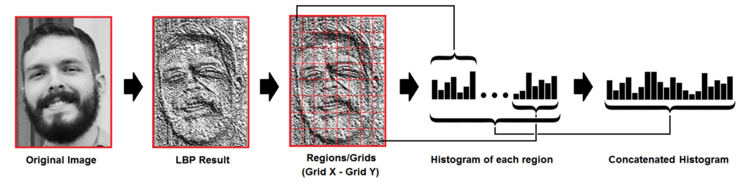
4. Extracting the Histograms: Now, using the image generated in the last step, we can use the Grid X and Grid Y parameters to divide the image into multiple grids
5. Performing face recognition: In this step, the algorithm is already trained. Each histogram created is used to represent each image from the training dataset. So, given an input image, we perform the steps again for this new image and create a histogram that represents the image.

Slide 16
References
[1] Kaur, Jashanpreet & Akanksha, & Singh, Harjeet. (2018). Face detection and Recognition: A review.
[2] Wiskott, Laurenz & Fellous, Jean-Marc & Recognition, Face & Potzsch, Michael & Kruger, Norbert & von der Malsburg, Christoph. (1999). Processing, vol. 36, pp. 1169--1179, July 1988. [33] R.P. Wurtz, "Object recognition robust under translations, deformations, and changes in the background",.
[3] Bamba, Inshita & Yashika, & Singh, Jahanvi & Chawla, Pronika. (2022). Face Recognition Techniques and Implementation. 10.1007/978-981-19-4052- 1_35.
[4] Bate, Sarah & Dalrymple, Kirsten & Bennetts, Rachel. (2022). Face recognition improvements in adults and children with face recognition difficulties. Brain Communications. 4. 10.1093/brain comes/fcac068.

Slide 17
Thank You
- Team 12

